Slide 1
GO(lang) – Concurrent Programming
CIS4930 – Concurrent Program

Slide 2
Joseph Cutrono
Undergrad / Masters ‘07 alumnus
Ultimate Software
Page development
Architectural design
Gopher evangelist
Innovation

Slide 3
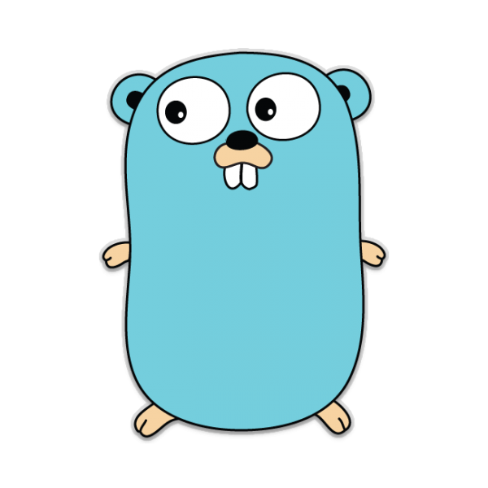
Why GO?
Speed - Development (Programming / Compilation)
Concurrency at its heart
Idiomatic – one/few way to do things
Speed - Compilation
No dependencies (dlls) to link
Speed - Deployment
1 exe can run anywhere

Slide 4
Example 1 - Intro
Some basics about GoRoutines
Gthreads –
OS threads are scheduled to run against available processors
Goroutines are scheduled by the Goruntime to run within a logical processor that is bound to a single OS thread

Slide 5
Simple right?
Functions as first class citizens
OOP when you need it (kind of)
Java + Python + Magic = GO

Slide 6

Example 2 - i++
How hard could that be?

Slide 7

Example 2 - Mutex
In a world where we want things to execute in parallel, lets slow things down for a bit and bid a solemn farewell to all those threads we lost tonight

Slide 8

Example 3 – Channel communication
"Share memory by communicating, don't communicate by sharing memory."

Slide 9
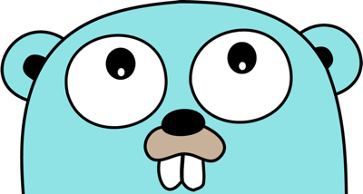
What should I use?
Use what makes sense. What would be the least surprising implementation expected. Go with that, don’t get cute. Leave that to the Golang gopher
Channels are least efficient in the case of one writer and many readers

Slide 10

Questions

Slide 11
References
https://gobyexample.com/
http://marcio.io/2015/07/singleton-pattern-in-go/

